Slide 1

Work-From-Home
By Karen Delapaz
Notes:
Hello everyone, Today I will be presenting on a workplace trend that has been growing in recent years. Work-from-Home has gotten a lot of attention in media since its growth was accelerated due to the pandemic.
O lets look at what the data showing about its impact on workers as its prevalence in the workplace is becoming more common?

Slide 2

Notes:
First, I’d like to cover data from the US Census covering the years 2019 through 2021 where the percentage of positions that are Home, On-site, or Mixed/Hybrid were captured and tracked across three sectors of work (Government, Private Sector, or Self-Employed).
When looking at this data, you may notice that the percentage of work-from-home jobs jumped significantly from 2019 to 2020.
The highest jump being in the Government sector which experienced around a 16 to 17% jump in work-from-home jobs due to the pandemic. This large shift towards work-from-home during the pandemic can also be captured in the sharp decline of On-site jobs which decreased approximately 19% over the same time period. Similarly, the other two sectors experienced the same realignments only to a lesser extent.
While the work-from-home jobs experienced a slight retraction in 2021, this could be explained due to the easing of pandemic restrictions as well as inertia in the job market by employers to adopt a work-from-home model more permanently.

Slide 3
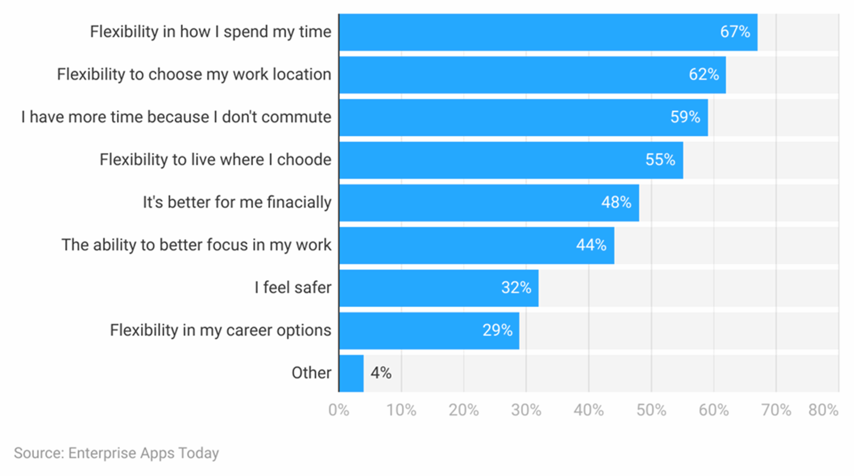
Remote Work Statistics By Benefits
Flexibility in how I spend my time
Flexibility to choose my work location
I have more time because I don’t commute
Flexibility to live where I choose
It’s better for me financially
The ability to better focus in my work
I feel safer
Flexibility in my career options
Other
Notes:
So what are some of the main benefits that people report from working at home?

Slide 4
Notes:
In a survey sourced from Kaggle.com, when it comes to saving time, the 60% of respondents said they felt like they did not save time.
So personally I work Hybrid and for me I do save on time since my commute is about 45 min on good days
Majority said
70% of remote workers believe they feel more productive while working remotely

Slide 5

Negatives from working from home
Problem | Share of people reporting it
Not being able to unplug | 25%
loneliness | 24%
Being in a different time zone than teammates | 21%
Staying Motivated | 21%
Difficulties with collaborating and communication | 17%
Other | 4%

Slide 6
General Remote Work Statistics
Only 5% of executives believe in having fully remote offices to strengthen the company culture.
Around the globe, 82% of managers are allowing their employees to work remotely.
For every mobile work employee, companies save around $22K every month. On the employee side, employees save an average of $4000 every year due to a reduction in commuting.
42% of employees face problems with setting boundaries while being remote from the office.
According to a survey conducted by Remote Work Statistics, 33% of surveyed employees said if mobile work is not provided as an option, they might leave their current job
On average, women are more likely to work remotely than men according to a survey conducted by Remote Work Statistics.
According to Remote Work Statistics, around 74% of companies spread around the globe are planning to provide permanent mobile work.
80% of employees said they will recommend working remotely to their friends.

